Slide 1
The Sleeping Teaching
Assistant
Final Presentation
CMPE 180 C
Group 4
Team Members:
Jay Parsana 013779389
Vatsal Makani 013731614
Yash Amin 013006253

Slide 2

What is the Sleeping TA problem?
TA is either awake and helping a student, or is asleep when is he is not.
TA can only cater to one student a time, while a maximum of three students can be seated outside the TA’s room waiting to be addressed.
This is classic problem concerning access to the critical section which is resolved here with the implementation of Mutex and Semaphores.
Notes:
In computing, a data warehouse (DW or DWH), also known as an enterprise data warehouse (EDW), is a system used for reporting and data analysis, and is considered a core component of business intelligence.^{[1]} DWs are central repositories of integrated data from one or more disparate sources. They store current and historical data in one single place^{[2]} that are used for creating analytical reports for workers throughout the enterprise.

Slide 3
S0
S1
S2
S3
S4
Analogous to process that want to access Critical Section.
Students doing Programming Assignments
Chair 1
Chair 2
Chair 3
TA Office
Analogous to the Waiting Queue.
Analogous to the Critical Section.

Slide 4
What are Mutex Locks?
Used to protect the critical region.
Prevents the Race Condition.
A process acquires a lock when it enters the critical section and release the lock when it exits the critical section.
Busy Waiting was the problem with the Mutex Locks.
While a process is in its critical section, other process that tries to enter its critical section must loop continuously.
Also called Spinlock.

Slide 5
What are Semaphores?
Concept of wait() and signal() was introduced.
Process enters the critical section when values of variable S(Semaphore) >0;
This values of S is incremented when the process leaves the critical section.
If a process wants to execute and S<0, it goes into the waiting queue.
This process is restarted when the process in the Critical section exits and executes the signal() operation.

Slide 6
S1
S2
S3
S4
Students doing Programming Assignments
Chair 1
Chair 2
Chair 3
S0
TA Office

Slide 7
S1
S2
S3
S4
Students doing Programming Assignments
Chair 1
Chair 2
Chair 3
TA Office
S0

Slide 8
S1
S2
S4
Students doing Programming Assignments
Chair 1
Chair 2
Chair 3
S3
TA Office
S0

Slide 9
S1
S2
Students doing Programming Assignments
Chair 1
Chair 2
Chair 3
S3
S4
TA Office
S0

Slide 10
S1
Students doing Programming Assignments
Chair 1
Chair 2
Chair 3
S3
S4
S2
TA Office
S0

Slide 11
S0
S1
Students doing Programming Assignments
Chair 1
Chair 2
Chair 3
S3
S4
S2
TA Office

Slide 12
S0
S1
Students doing Programming Assignments
Chair 1
Chair 2
Chair 3
S4
S2
TA Office
S3

Slide 13
S0
S1
Students doing Programming Assignments
Chair 1
Chair 2
Chair 3
S4
S2
TA Office
S3

Slide 14
S0
Students doing Programming Assignments
Chair 1
Chair 2
Chair 3
S4
S2
S1
TA Office
S3

Slide 15
S0
Student 0 needs help but it cannot enter the waiting queue and resumes working.
Students doing Programming Assignments
Chair 1
Chair 2
Chair 3
S4
S2
S1
TA Office
S3

Slide 16
S0
S3
Students doing Programming Assignments
Chair 1
Chair 2
Chair 3
S4
S2
S1
TA Office

Slide 17
S0
S3
Students doing Programming Assignments
Chair 1
Chair 2
Chair 3
S2
S1
TA Office
S4

Slide 18
S0
S3
Students doing Programming Assignments
Chair 1
Chair 2
Chair 3
S2
S1
TA Office
S4

Slide 19
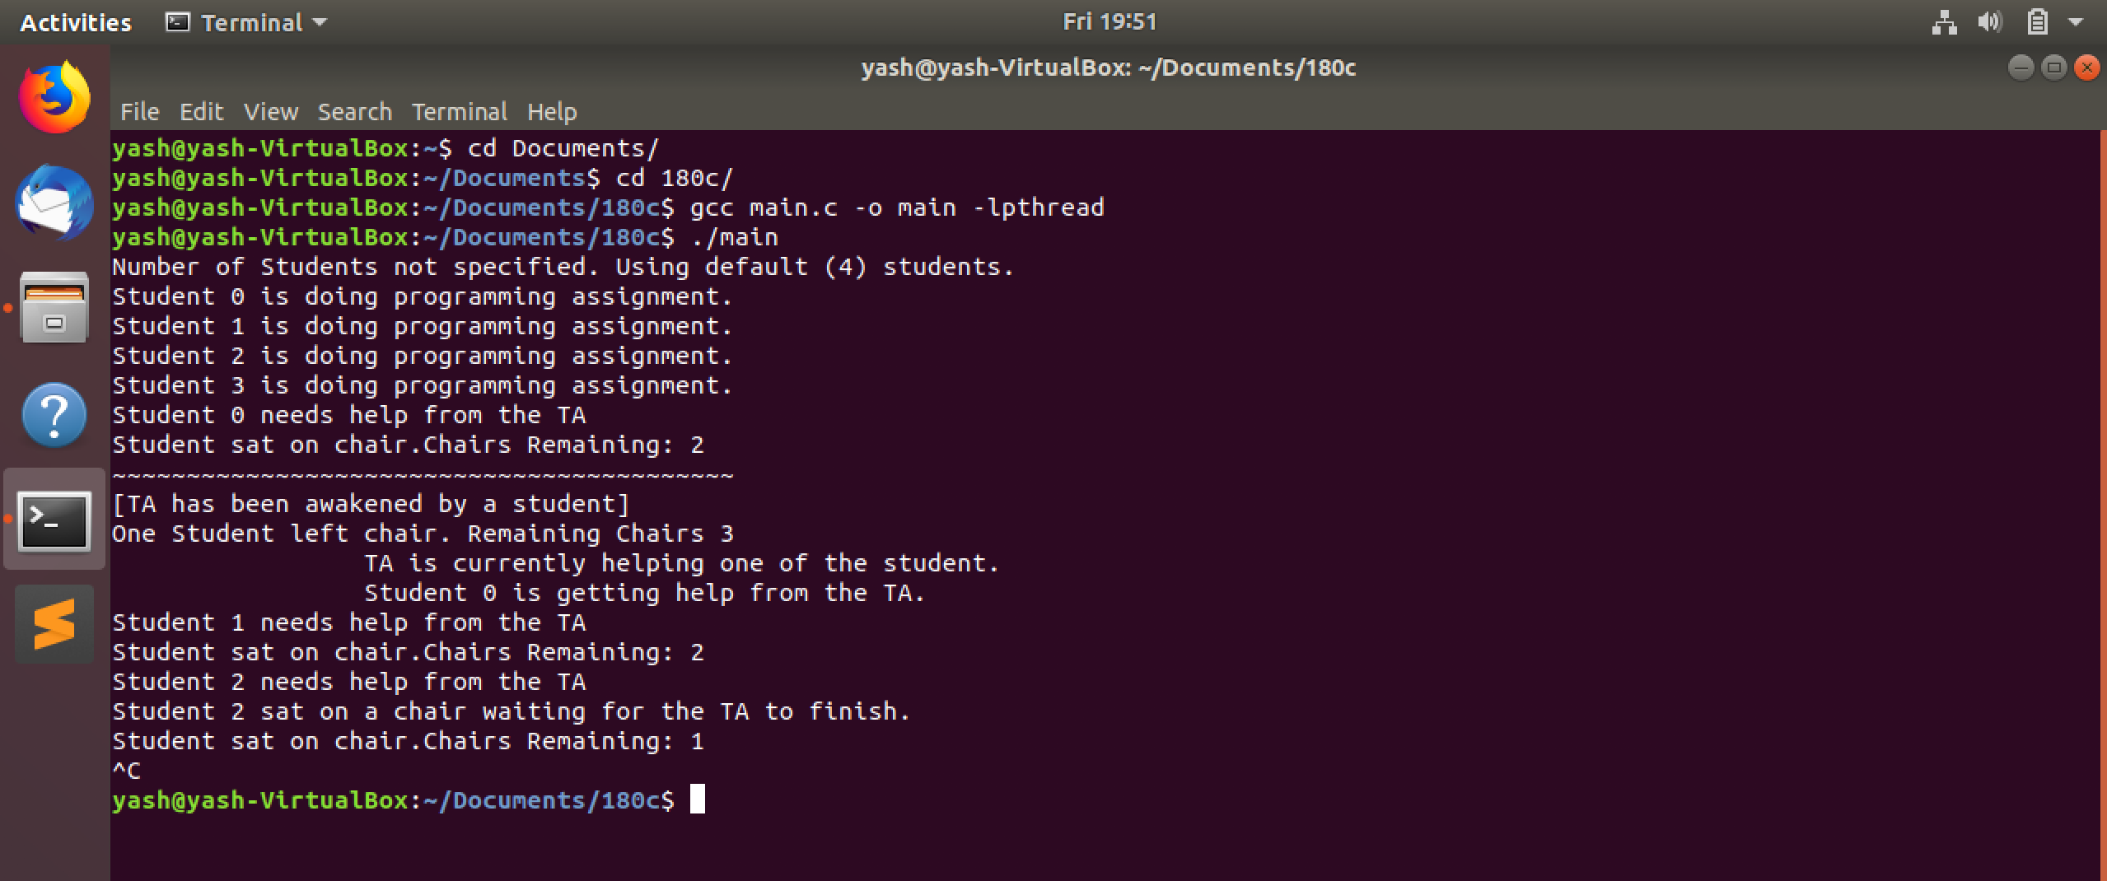

Slide 20
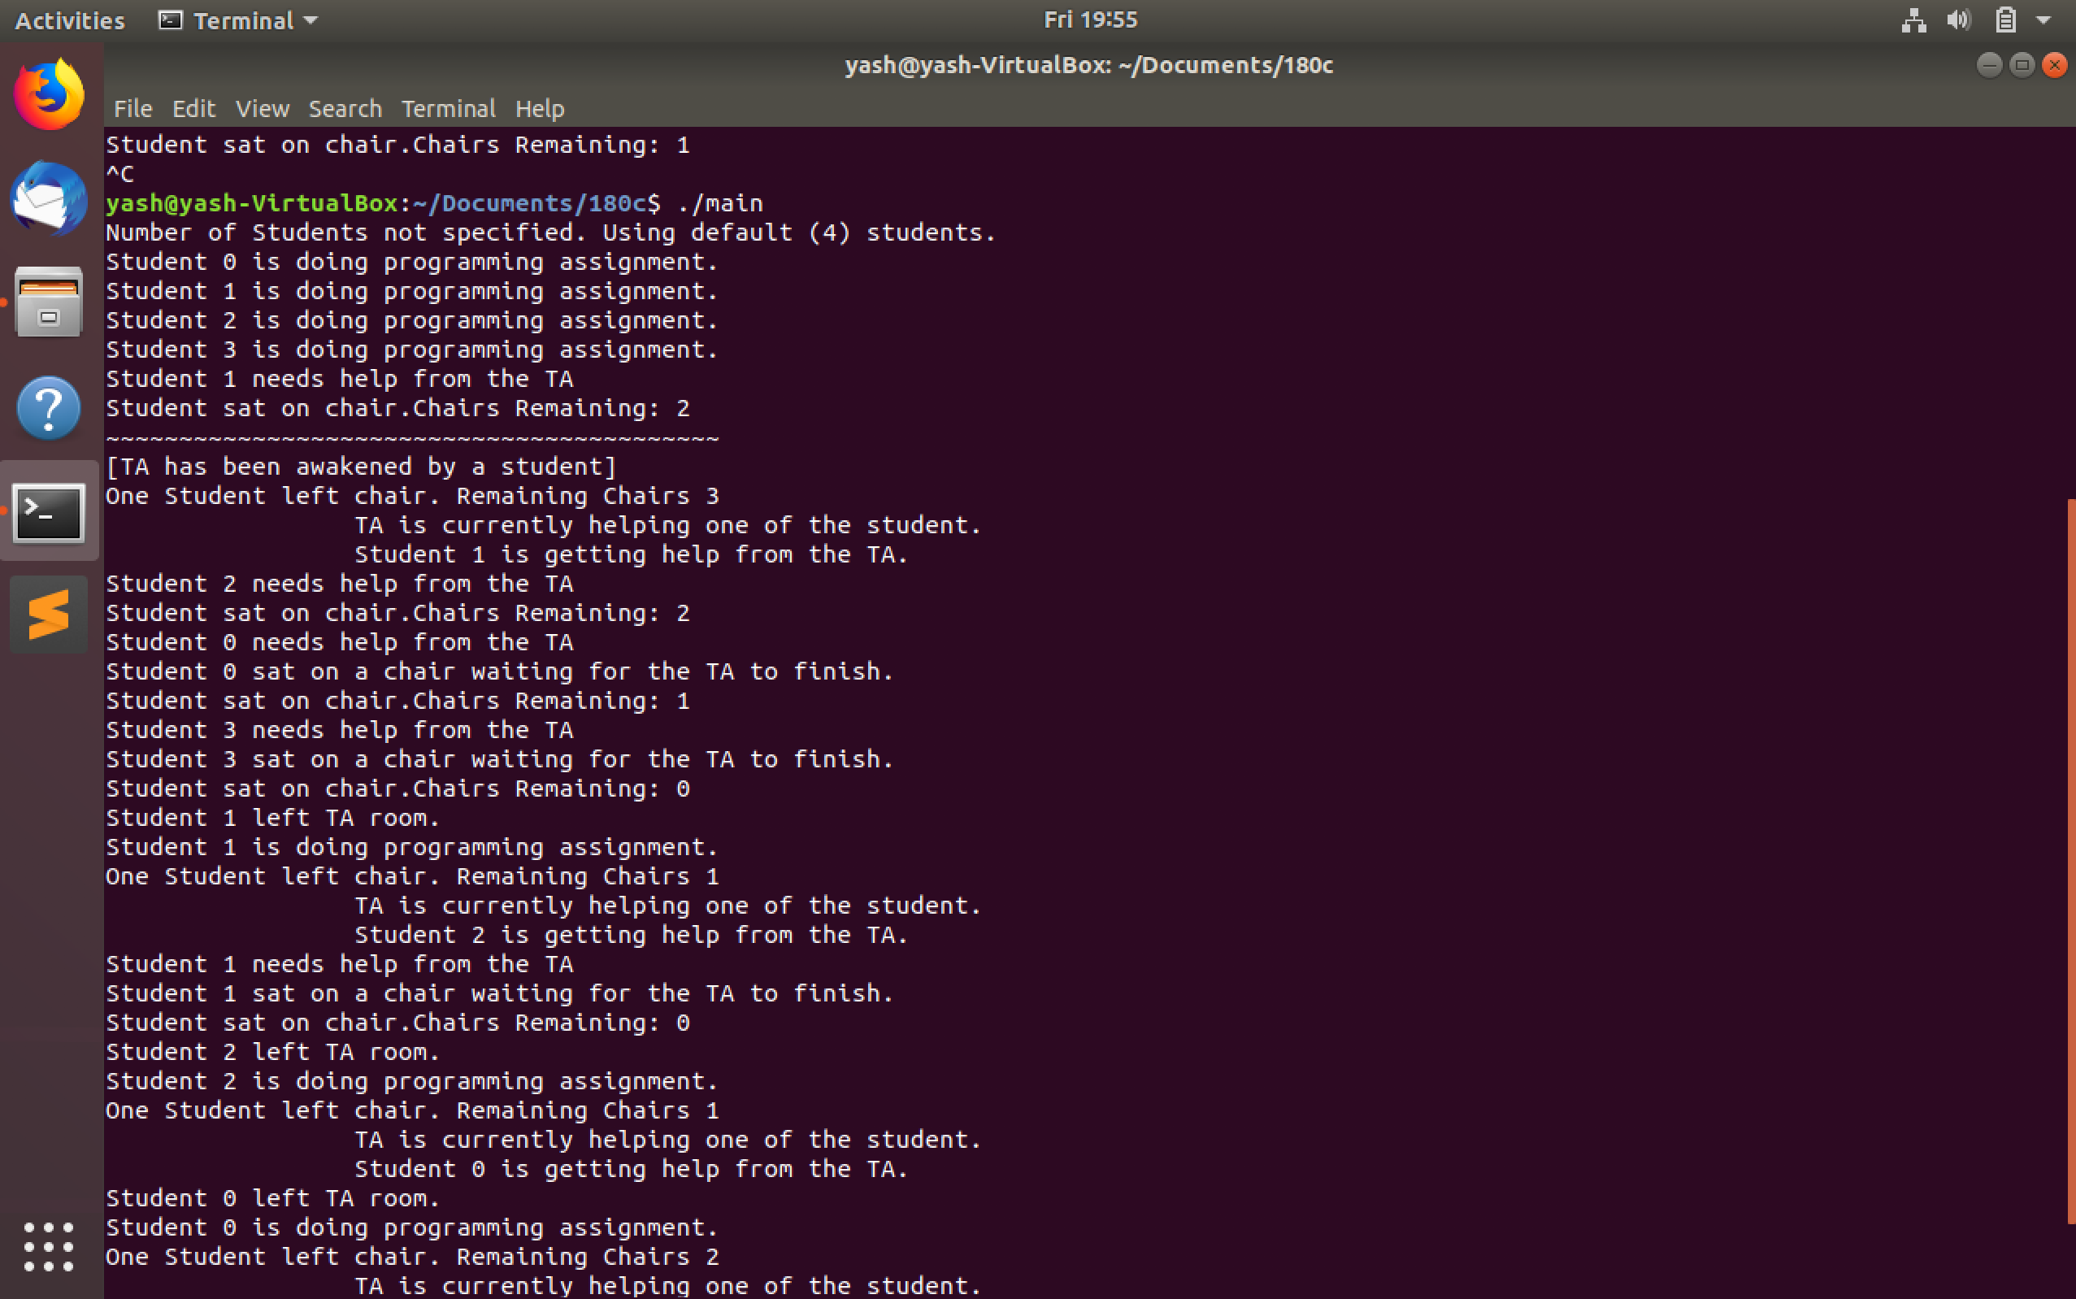

Slide 21
Since 0 Chairs are left, more students cannot come to seek help from the Teaching Assistant.

Slide 22
Student 1 left the TA room and continues with his assignment.
Student 2 now enters the TA room. Students enter in FIFO order in TA office.

Slide 23
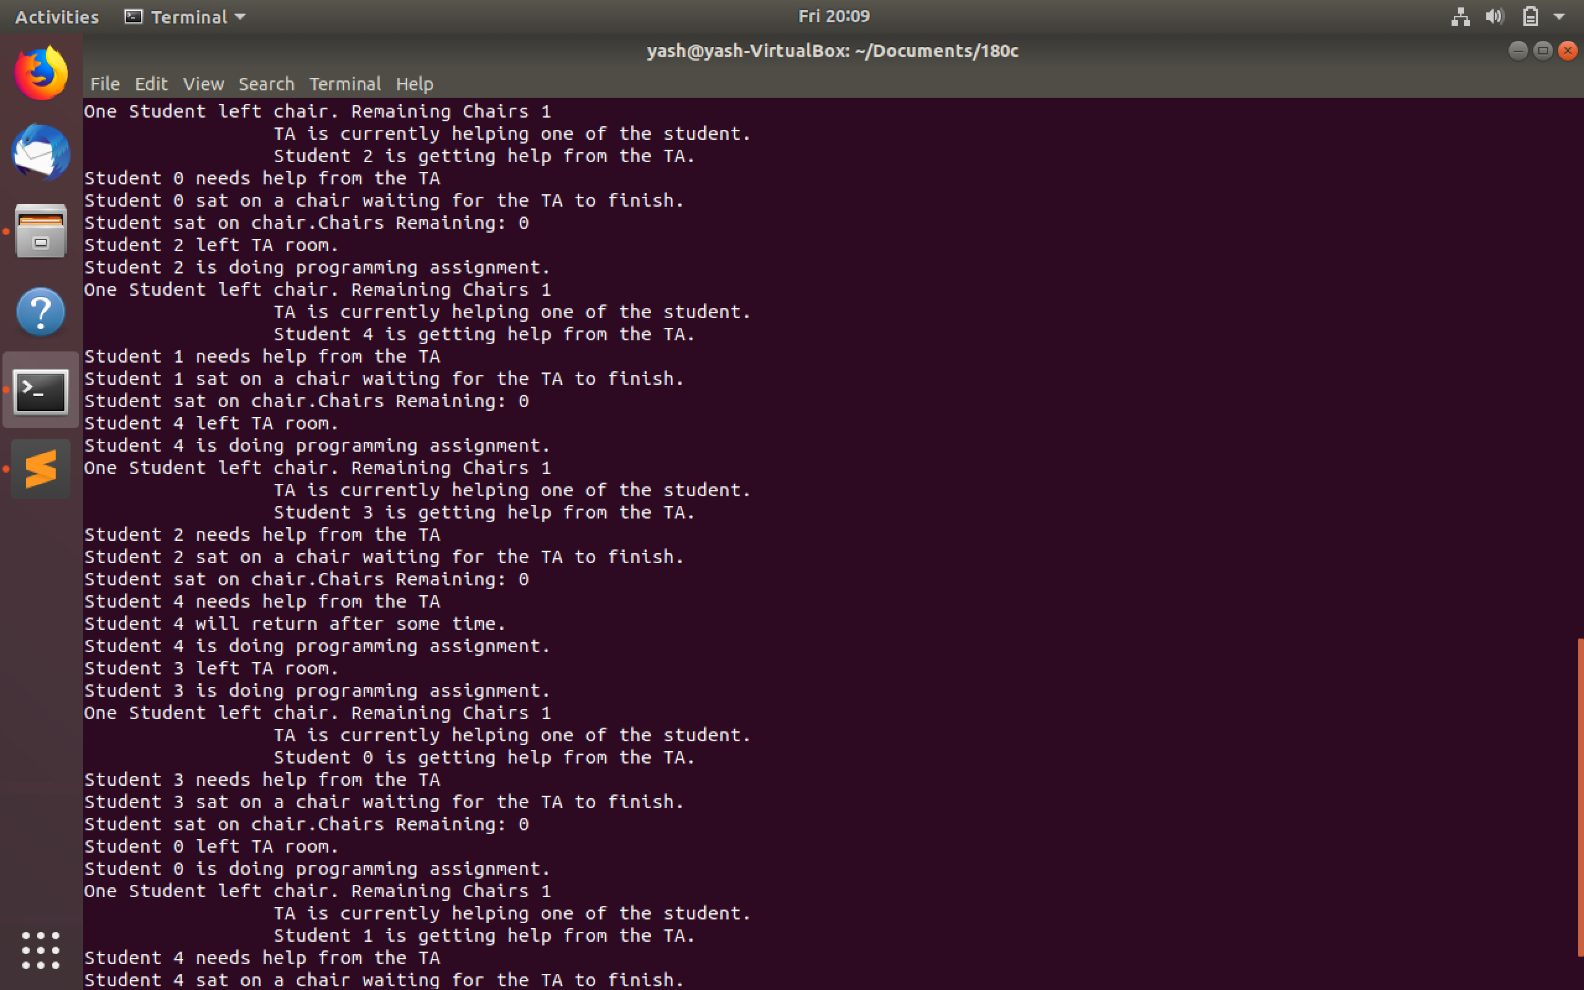
Student 2 occupies the position vacated by student 3
Since all the chairs are occupied, if any student needs help, it will not be able to enter the queue and resume working.

Slide 24
Thank You.

